Slide 1

High-Capacity Image Steganography Based on Improved FC-DenseNet
Guide:
Hemanth Kumar N P
Present By:
Jayalakshmi M
4AL17CS035

Slide 2
01
Introduction
Agenda
02
Statement of the problem
03
Objectives
04
Methodology
05
Applications
06
Conclusions
07
References

Slide 3
Introduction:
Image Steganography refers to the process of hiding data within an image file.
The image selected for this purpose is called the cover-image and the image obtained after steganography is called the stego-image.
The most common steganography is to embed secret information into the Least Significant Bits(LSB) of natural images, LSB digit of the pixel is easily replaced by secret information, which is easy to produce visual artifacts.
Steganography

Slide 4
Statement of the problem:
How can we send a message secretly to the destination.
Using steganography, information can be hidden in carriers such as images, audio files, text files, videos and data transmissions.
A new framework of an image steganography system to hide a digital text of a secret message.
!

Slide 5

Objectives
Secure Private Files and Documents
Hide Passwords and Encryption Keys
Transport Highly Private Documents between International Government
Transport message/data without revealing the existence of available message

Slide 6
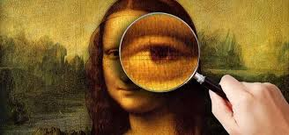
Methodology:
Most common and popular method of steganography is to make use of LSB( Least Significant Bit) algorithm.
LSB substitution is the process of adjusting the least significant bit pixels of the carrier image.
For 24 bit image, the colors of each component like RGB (red, green and blue) are changed. LSB is effective in using BMP images since the compression in BMP is lossless.
It is a simple approach for embedding message into the image.

Slide 7
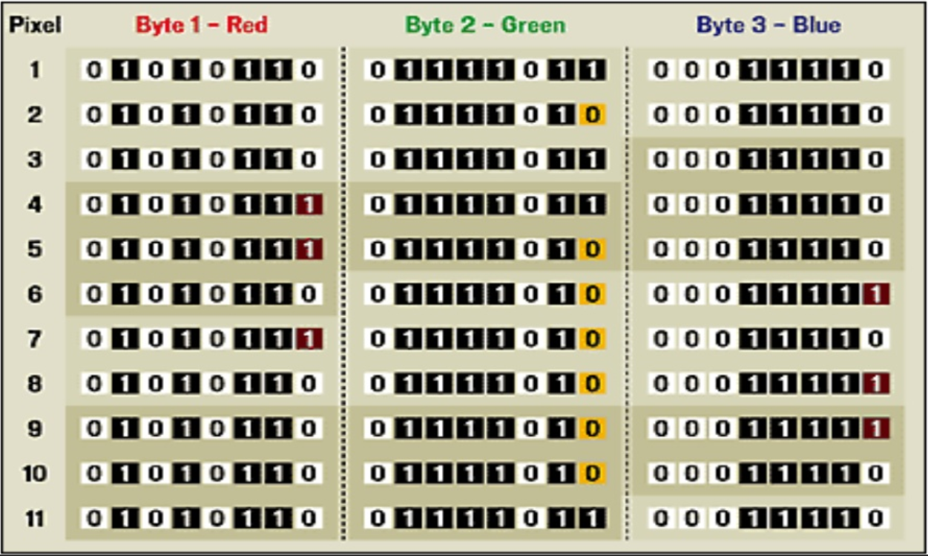

Slide 8

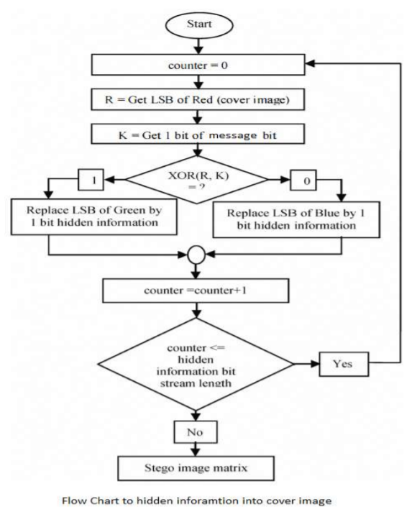
LSB Encoding Algorithm :

Slide 9
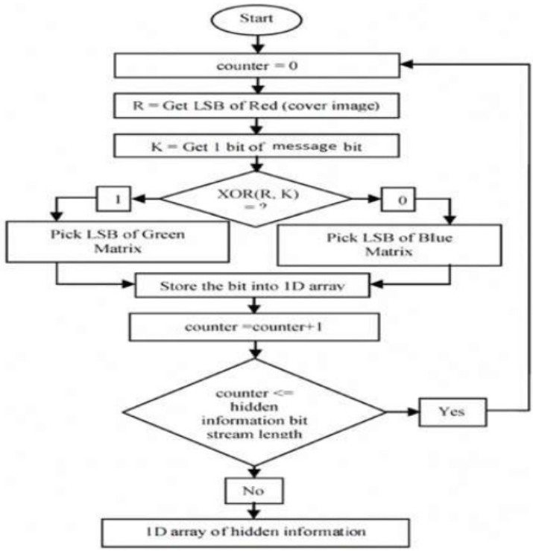
LSB Decoding Algorithm :

Slide 10
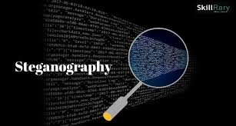
Some Failures that Occurred:
Gradient dissipation and gradient explosion.
Large number of features are multiplexed.
Reconstruct good image quality after entering the network.
Low steganographic capacity.

Slide 11
Evolution :
It overcame by using the steganographic scheme based on Fully Convolutional Dense Connection Network (FC-DenseNet).
Were it has a high Peak Signal-to-Noise Ratio(PSNR) and Structural Similarity(SSIM).
And also large-capacity image steganography, with an average image payload capacity of 23.96 bit per pixel.

Slide 12
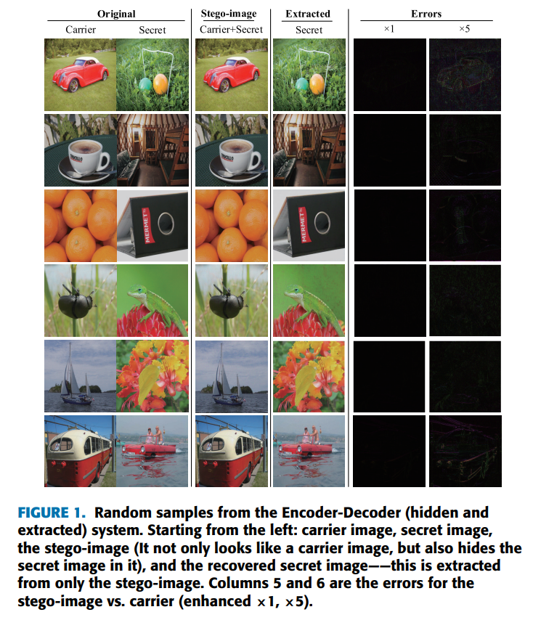
Fig. 1. Random samples from the Encoder-Decoder (hidden and extracted) system. Starting from the left: carrier image, secret image,the stego-image (It not only looks like a carrier image, but also hides the secret image in it), and the recovered secret image——this is extracted from only the stego-image. Columns 5 and 6 are the errors for the stego-image vs. carrier (enhanced ×1, ×5).

Slide 13
Application And Development Of FC-DenseNet :
FC-DenseNet is mainly used for Semantic segmentation.
The main process is to add a downsampling and upsampling function behind the Dense Block.
FC-DenseNet
The down sampling is a 2 × 2 convolution block used to extract the maximum value of the feature map to reduce the image and simplify the calculation.
The UPSAMPLING is composed of a 3×3 transposed convolution, and the convolution kernel has a step size of 2 to compensate for the pooling operation.

Slide 14

Network Architecture :
Architecture mainly contains concatenation and an encoder (Hiding Network) and a decoder (Reveal Network).
The encoder is mainly used to hide secret information and the decoder is mainly used to extract secret information.

Slide 15
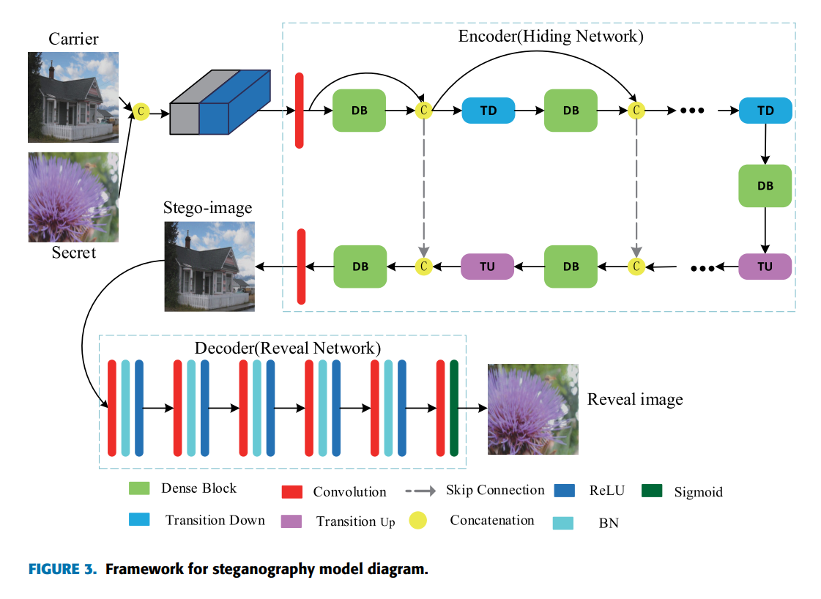
Fig. 2. Framework for steganography model diagram.

Slide 16
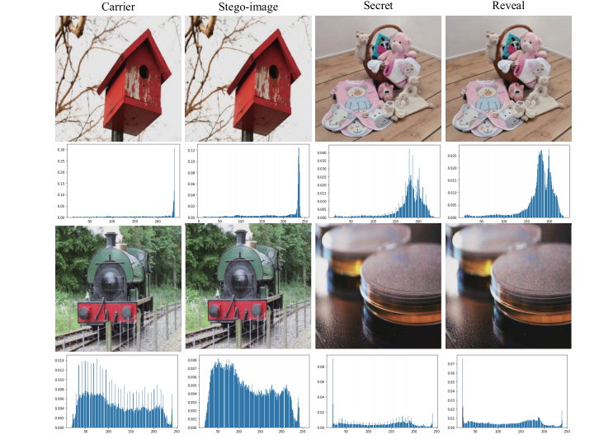
Histogram Variation
Fig. 3. From the left: carrier image, stego-image, secret image, and
the recovered secret image. The 2th and 4th line histograms correspond

Slide 17
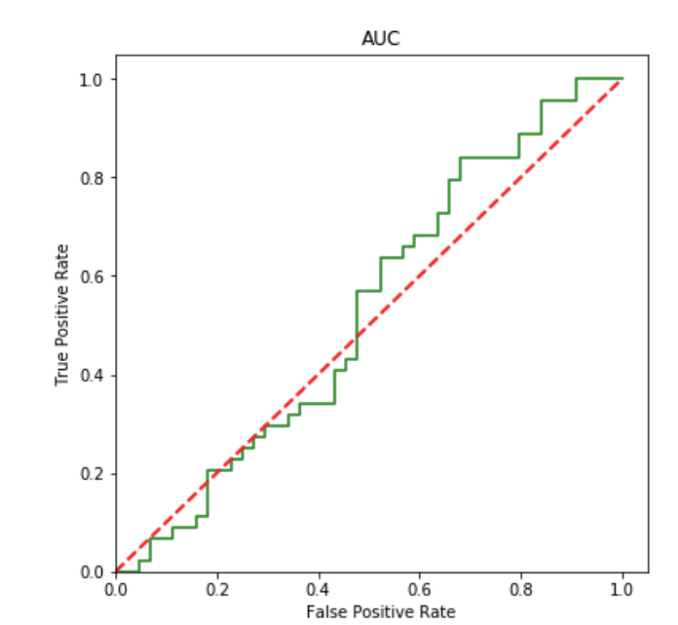
Fig. 4. Get ROC curve with StegExpose analysis tool

Slide 18
Conclusion
Through the end-to-end training model, the full-size image is hidden and the image distortion is small.
It shows that the method has advanced visual effects and high steganography capacity, and the model has strong generalization ability, which can achieve steganography and extraction of different data sets.

Slide 19
“Lossless data hiding for absolute moment block truncation coding using histogram modification,’’
, ‘‘A novel image steganography method via deep convolutional generative adversarial networks,’’
C. Kim, D. Shin, L. Leng, and C.-N. Yang,J. Real-Time Image Process., vol. 14, no. 1, pp. 101–114, Jan. 2018.
REFERENCE
D Hu, L. Wang, W. Jiang, S. Zheng, and B. LiIEEE Access, vol. 6, pp. 38303–38314, 2018.
“DNA based image steganography”
‘‘Invisible steganography via generative adversarial networks,’’
. Vinodhini and P. Malathi, in Computational Vision and Bio Inspired Computing, vol. 28. Cham, Switzerland: Springer, 2018, pp. 819–829
R. Zhang, S. Dong, and J. Liu, Multimedia Tools Appl., vol. 78, no. 7,pp. 8559–8575, Apr. 2019.
‘‘Minimizing embedding impact in steganography using trellis-coded quantization,’’
‘‘Technology of hiding and protecting the secret image based on two-channel deep hiding network,’’
F. Chen, Q. Xing, and F. Liu, IEEE Access,vol. 8, pp. 21966–21979, 2020.
T. Filler, J. Judas, and J. Fridrich, Proc. SPIE, vol. 7541, Jan. 2010, Art. no. 754105

Slide 20
THANK YOU

